Slide 1
DATA ANALYSIS
CONCEPTUALIZATION
Lusana

Slide 2

Be cheerful! Keep smiling!
A child laughs 200 times a day!
A college student 100 times a day! Married 20 times a day!
Laughter reduces with age, leading to all ailments
Laughter increases immunity, blood circulation and brain power

Slide 3
What is data analysis?????
The process of evaluating data using analytical and logical reasoning to examine each component of the data provided.
Riminder
The analysis of data is just one of the many steps that must be completed when conducting a research project.
Reasonable and logical data is gathered, reviewed, and then analyzed to form some sort of finding or conclusion.

Slide 4
WHY DO WE ANALYZE DATA????
The purpose of analyzing data is to obtain usable and useful information.
The analysis, irrespective of whether the data is qualitative or quantitative, may:
Describe and summarize the data
Identify relationships between variables
Compare variables
Identify the difference between variables
Forecast outcomes

Slide 5
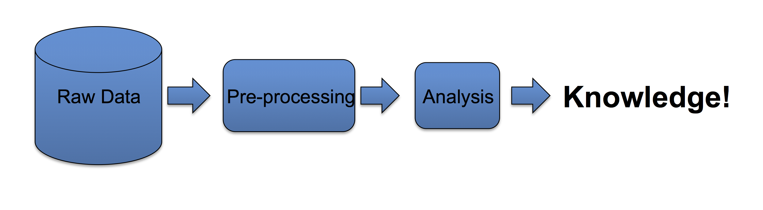

Slide 6
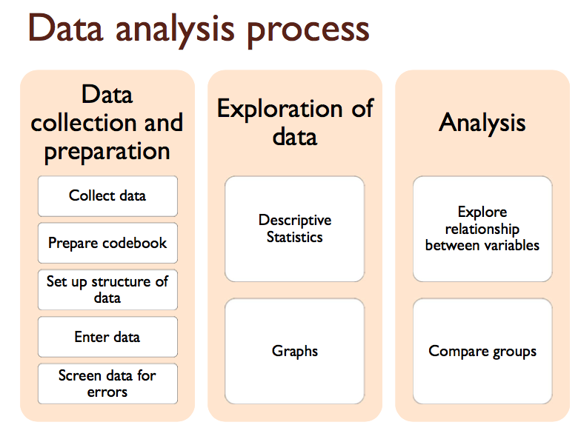

Slide 7
TOOLS TO SUPPORT DATA ANALYSIS
Spreadsheet – simple to use, basic graphs
Statistical packages, e.g. SPSS, R software, SAS/STAT, Matlab, PAST, etc
Qualitative data analysis tools e.g. HubSpot, NVivo, MAXODA, webQDA etc

Slide 8
Initial preparation
Prior to conducting any data analysis ask yourself the following???
What data am I using?? Analytical methods??
Descriptive Statistics, help us to simplify large amounts of data in a sensible way. Each descriptive statistic reduces lots of data into a simpler summary.
Then we use inferential (analytical) statistics to make judgments of the probability that an observed difference between groups.
Generally, we use inferential statistics to make inferences from our data to more general conditions; we use descriptive statistics simply to describe what's going on in our data.

Slide 9
For our case (In most cases) at this level
We don’t focus on descriptive statistics.
Only a roadmap to inferential (analytical) statistics
Most of the major inferential statistics come from a general family of statistical models known as the general linear model. Including
The t-test,
Analysis of Variance (ANOVA),
Analysis of Covariance (ANCOVA),
Regression analysis,
Correlation
etc

Slide 10
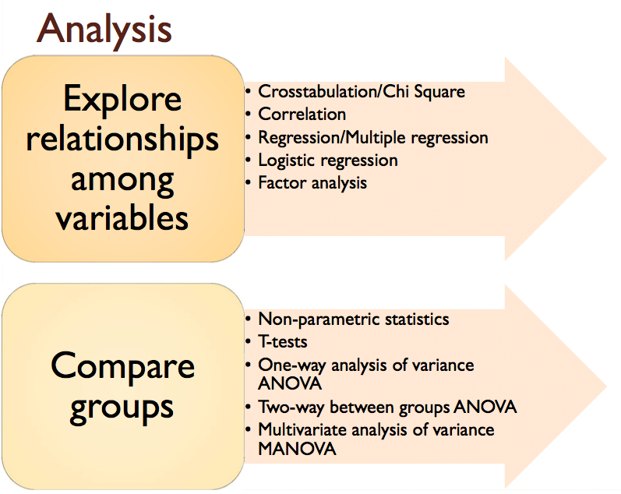

Slide 11
Commonly used Analytical statistical techniques
Parametric tests
A statistical test, in which specific assumptions are made about the population parameter
Include students T-test, Pearson correlation, ANOVA etc.

Slide 12
Non parametric tests
Researcher has no idea regarding the population parameter.
Include Kruskal wallis, chi-square test, Mann Whitney test

Slide 13
T-test
Probably the most commonly performed statistical procedure
Typical use of this test is to compare means
This test is easy to use, it is also easily to be misused.

Slide 14
Types of t-test
One-sample t-test
Compares a single mean to a fixed number or “gold standard
Two-sample t-test,
Compares two population means based on independent samples from the two populations or groups
Paired t-test,
Compares two means based on samples that are paired in some way

Slide 15
Rules of thumb for one sample t-test
If the sample size is small (less than 15), then you should not use the one-sample t-test if the data are clearly skewed or if outliers are present.
If the sample size is moderate (at least 15), then the one-sample t-test can be safely used except when there are severe outliers.
If the sample size is large (at least 40), then the one-sample t-test can be safely used without regard to skewness or outliers.

Slide 16
How to statistically compare diversity indexes?
Most diversity indexes behave non-linearly, while most statistical tests assume linearity.
Before beginning any sort of statistical analysis, you should strongly consider transforming your data from diversity indices into effective species counts. Indexes such as Simpson's and Shannon's are highly nonlinear.
The Shannon t test is described
The Simpson t test is given

Slide 17
ANOVA-TEST
What is this test for?
The one-way analysis of variance (ANOVA) is used to determine whether there are any statistically significant differences between the means of three or more independent (unrelated) groups.
At this point, it is important to realize that the one-way ANOVA is an omnibus test statistic and cannot tell you which specific groups were statistically significantly different from each other
To determine which specific groups differed from each other, you need to use a post hoc test.

Slide 18
Just like in One way ANOVA, what happens in the two way ANOVA is just the same.
Only that the independent variables are two.
Two-way Analysis of Variance
Aim: test for main effect and interaction effects on the dependent variable
Requirements: ◦ Two (categorical variables)/independent variable ◦ Only one (continuous variable)/dependent variable

Slide 19
Assumptions of two way ANOVA
The population must be close to normal distribution
Samples must be independent
Population variances must be equal
Groups must have equal sample size

Slide 20
Factorial ANOVA
Analysis of variance test with more than one independent variable/factor
It can also refer two more than one level of independent variable
E.g. Experiment with a treatment group and a control group has one factor (treatment) but two levels (treatment and control)
The terms two way and three way refer to the numbers of factors /number of levels in your test.

Slide 21
Correlation and regression
Correlation- A mathematical measure of the strength of association between two quantitative variables
A closely related cousin of correlation analysis is regression analysis
In regression analysis the interest is to determine how changes of some variables influence the change of values of other variables, e.g. how increasing the protein level in a feed affects daily weight gain.
Multiple regression procedure is used when the change of a dependent variable is explained by changes of two or more independent variables.

